Slide 1
Leverage Ratio
xample.com

Slide 2
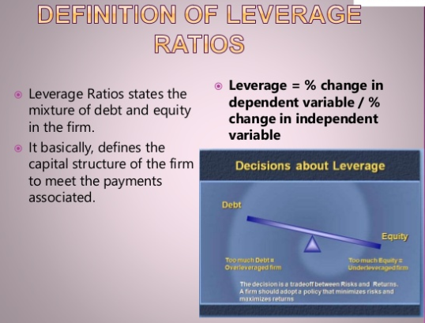

Slide 3
Leverage ratio
Leverage ratios measure how leveraged a company is.
Highly leveraged means that the company has taken on too many loans
and is in too much debt.
These ratios indicate the long term solvency of a firm and indicate its ability of the firm to meet its long term commitment to:
Repayment of amount on maturity or in predetermined instalments at due dates and
Paying off loans with interest

Slide 4

Also a riskier source of finance
Companies that are too highly leveraged (that have large amounts of debt as compared to equity) often find it difficult to grow because of the high cost of servicing the debt
A change in interest rates can have an effect on one’s profit too

Slide 5
1) Debt- equity ratio
1) Debt equity ratio
Interest coverage ratio
Debt service coverage ratio
Debt ratio
Leverage Ratios

Slide 6
Debt- equity ratio
The Debt-to-Equity ratio (D/E) indicates the proportion of the company’s assets that are being financed through debt.
This ratio tells us how much loan and equity was used to purchase assets

Slide 7
A higher debt-equity ratio indicates a levered firm, which is quite preferable for a company that is stable with significant cash flow generation, but not preferable when a company is in decline.
Conversely, a lower ratio indicates a firm less levered and closer to being fully equity financed. The appropriate debt to equity ratio varies by industry.

Slide 8
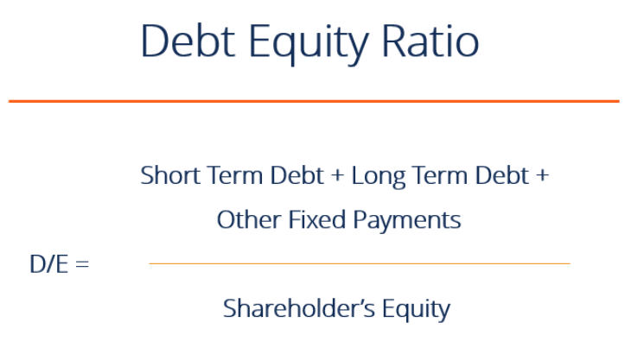

Slide 9
In the example below, we see how using more debt (increasing the debt-equity ratio) increases the company’s return on equity (ROE). By using debt instead of equity, the equity account is smaller and therefore return on equity is higher.
Another benefit is that typically the cost of debt is lower than the cost of equity, and therefore increasing the D/E ratio (up to a certain point) can lower a firm’s weighted average cost of capital (WACC).

Slide 10
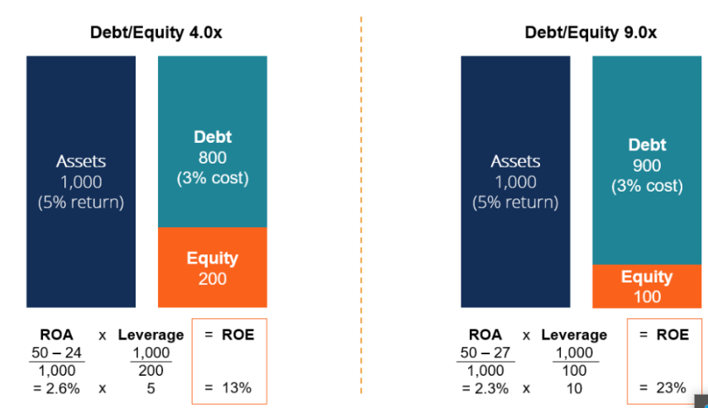

Slide 11
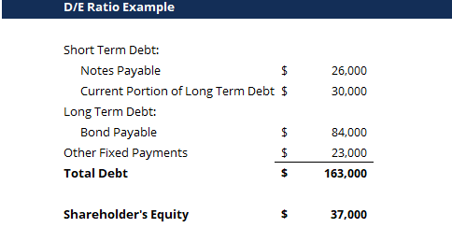

Slide 12
1) Capital-intensive industries tend to have higher debt-to- equity ratios than low-capital industries because capital- intensive industries must purchase more property, plants and equipment to operate
Analysis

Slide 13
Debt ratio
Debt ratio is a solvency ratio that measures a firm’s total liabilities as a percentage of its total assets. In a sense, the debt ratio shows a company’s ability to pay off its liabilities with its assets. In other words, this shows how many assets the company must sell in order to pay off all of its liabilities.
This ratio measures the financial leverage of a company. Companies with higher levels of liabilities compared with assets are considered highly leveraged and more risky for lenders.
This helps investors and creditors analysis the overall debt burden on the company as well as the firm’s ability to pay off the debt in future, uncertain economic times.

Slide 14

Formula
The debt ratio is calculated by dividing total liabilities by total assets. Both of these numbers can easily be found the balance sheet. Here is the calculation:

Slide 15
Analysis
The debt ratio is shown in decimal format because it calculates total liabilities as a percentage of total assets. As with many solvency ratios, a lower ratios is more favorable than a higher ratio.
A lower debt ratio usually implies a more stable business with the potential of longevity because a company with lower ratio also has lower overall debt. Each industry has its own benchmarks for debt, but .5 is reasonable ratio.

Slide 16
A debt ratio of .5 is often considered to be less risky.
This means that the company has twice as many assets as liabilities.
Or said a different way, this company’s liabilities are only 50 percent of its total assets.
Essentially, only its creditors own half of the company’s assets and the shareholders own the remainder of the assets.

Slide 17
A ratio of 1 means that total liabilities equals total assets.
In other words, the company would have to sell off all of its assets in order to pay off its liabilities.
Obviously, this is a highly leverage firm.
Once its assets are sold off, the business no longer can operate.

Slide 18
The debt ratio is a fundamental solvency ratio because creditors are always concerned about being repaid.
When companies borrow more money, their ratio increases creditors will no longer loan them money.

Slide 19
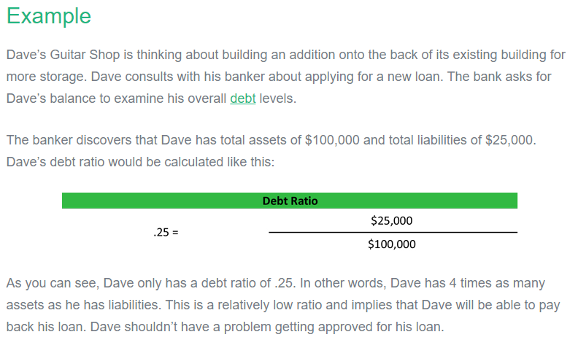

Slide 20

Interest coverage ratio

Slide 21
Uses:
Interest coverage ratio is also known as Times Interest Earned
ICR is a measure of company's ability to meets its interest payment; It determines how easily a company can pay interest expenses on outstanding debts
It is used to measure company's ability to make its interest payment on
its debt in timely manner

Slide 22

Coca cola
ICR= profit before interest and taxes/ Interest
ICR= 8.9/2.1 ICR=4.23
The final answer is 4.23 which indicates that the firm is doing really great.

Slide 23
Sarah’s Jam Company
Let’s take a look at an interest coverage ratio example. Sarah’s Jam Company is a jelly and jam jarring business that cans preservatives and ships them across the country. Sarah wants to expand her operations, but she doesn’t have the funds to purchase the canning machines she needs. Thus, she goes to several banks with her financial statements to try to get the funding she wants. Sarah’s earnings before interest and taxes is
$50,000 and her interest and taxes are $15,000. The bank would compute
Sarah’s interest coverage ratio like this

Slide 24
Formula
ICR= Profit before interest and taxes/ Interest
ICR= $50,000/$15,000
As you can see, Sarah has a ratio of 3.33. This means that has makes 3.33 times more earnings than her current interest payments. She can well afford to pay the interest on her current debt along with its principle payments. This is a good sign because it shows her company risk is low and her operations are producing enough cash to pay her bills.

Slide 25
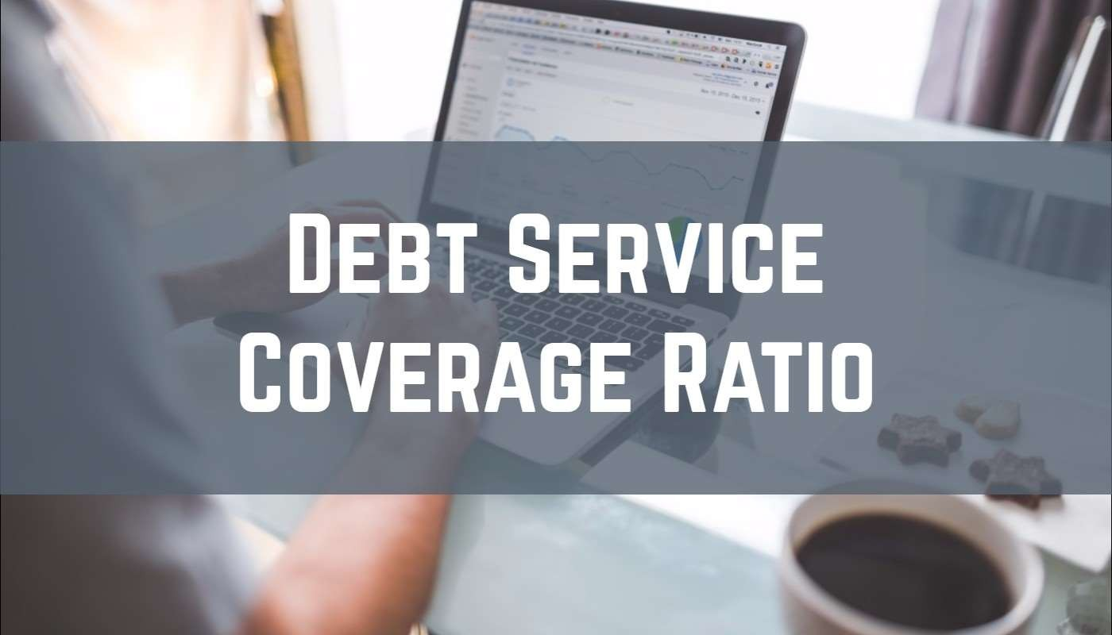

Slide 26
Debt Service Coverage Ratio
Ratio of cash a business has available for servicing its debts
Allows lenders to know whether or not a business can repay its potential loan
Calculated by comparing its net earnings with the amount of its loans & interest payments.

Slide 27
Importance
A financial scale a lender uses to determine whether or not the business produces enough cash flows
In business, unexpected expenses can arise.
Lenders make sure you have extra padding in your bank account.
Example: machinery break down.

Slide 28
Debt service coverage ratio
DSCR= Net operating income
Total debt service cost
Formula

Slide 29
Analysis
When net income = the cost of carrying loans it means your DSCR is 1
It tells you that your business is making just enough money to cover 100% of its current debts, without having a dip into its savings, sell of assets Or borrowing more money
A slightest reduction in earnings could cause a business to become
financially overextended

